Slide 1
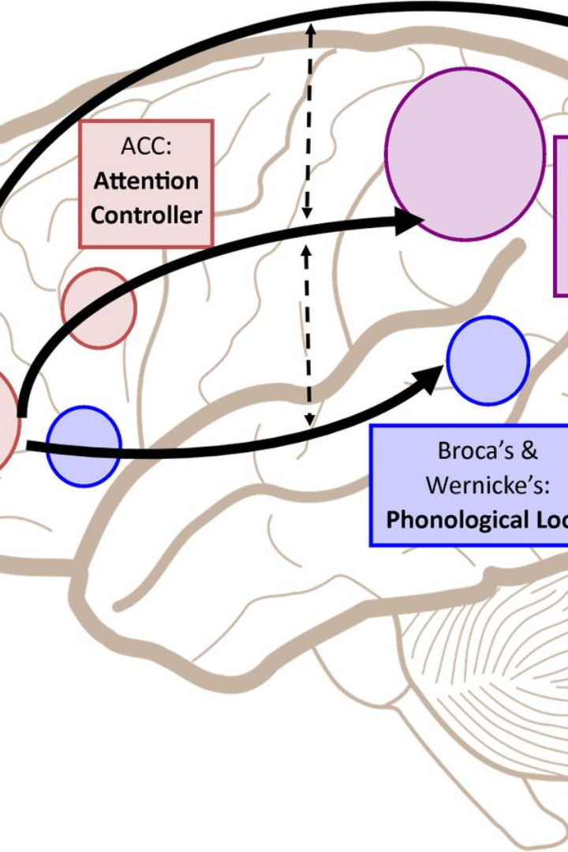


Introduction to Memory Paging
Memory paging is a crucial concept in computer architecture, allowing the operating system to efficiently manage memory. It involves the use of secondary storage to simulate additional main memory. The process plays a vital role in system performance and resource utilization.
Ja
by Joe Biden

Slide 2
What is Memory Paging?
Memory paging is a memory management scheme that enables the movement of data between the RAM and the disk. When RAM is filled, the OS moves data to an available space on the disk, thereby freeing up space in the RAM for running applications.
Working Principle
Pages of memory are transferred to and from the disk as needed.
Efficient Memory Usage
Enables multitasking by allowing more programs to run simultaneously.
Performance Impact
Paging can impact the speed of the system based on disk I/O operations.

Slide 3
Importance of Memory Paging Visualization
Visualizing memory paging concepts can aid in understanding complex memory allocation and management processes. It helps developers and system administrators optimize memory usage and reduce performance bottlenecks.
Complex Processes
Brings clarity to intricate memory management operations.
Performance Optimization
Identifying memory inefficiencies and bottlenecks becomes easier.
Training and Education
Enhances learning and development of memory management skills.

Slide 4
Features of the Memory Paging Visualization Tool
The memory paging visualization tool offers interactive and dynamic representations of memory allocation and paging algorithms. It includes features such as real-time data updates, customizable visualizations, and support for various paging strategies.
Interactive Interface
Allows users to interact with memory allocation processes.
Real-time Updates
Provides live data updates for immediate insights and analysis.
Multiple Paging Strategies
Supports different memory paging algorithms for comprehensive analysis.

Slide 5
How to Use the Memory Paging Visualization Tool
Using the memory paging visualization tool involves selecting memory access patterns, configuring page replacement algorithms, setting page table size, and observing real-time visualizations of memory paging operations. The tool offers in-depth insights into memory management processes.
Select Memory Access Patterns
Choose specific data access patterns for memory analysis.
Configure Page Replacement Algorithms
Set the algorithm for replacing pages in memory when full.
Observe Real-time Visualizations
View live representations of memory paging operations for analysis.

Slide 6
Benefits of Using the Memory Paging Visualization Tool
The tool facilitates proactive memory optimization by identifying memory hotspots, improving cache hit rates, and highlighting inefficient memory access patterns. It aids in predicting memory-related issues and optimizing system performance.
Increased Visibility
Cost-Efficient Optimization
Proactive Issue Identification

Slide 7
Case Studies and Examples
Several organizations have benefited from the memory paging visualization tool, with significant improvements in application performance, resource utilization, and proactive memory management. Case studies and examples demonstrate the practical impact of the tool in diverse computing environments.
Organization
Impact
Company A
20% faster application response time
Organization B
Reduced memory-related system crashes by 60%

Slide 8
Conclusion and Next Steps
Memory paging visualization tools are essential for modern computing systems. They provide insights into memory management, aid in performance optimization, and contribute to efficient resource usage. The next steps involve exploring advanced visualization techniques and integrating real-time monitoring capabilities.
Real-time Monitoring
Enable continuous tracking and analysis of memory usage.
Performance Optimization
Identify and rectify memory-related performance bottlenecks.
Exploring Advanced Techniques
Research and implement cutting-edge visualization methodologies.

